Slide 1
Wide Area Workflow (WAWF)
Releana DeScott
Business Integration Services
October 15-17, 2024

Slide 2
Wide Area Workflow (WAWF) Agenda
Electronic Commerce (EC) Tools Overview
Wide Area Workflow
Payment Systems – Legacy and Enterprise Resource Planning (ERP)
PIEE Help Desk
PIEE / WAWF Web Based Training (WBT) Opportunities
Questions

Slide 3

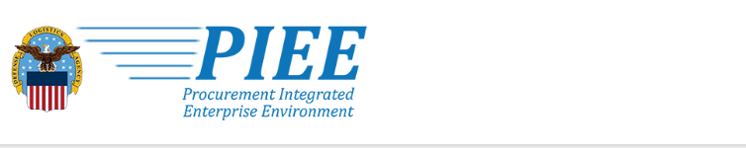



Electronic Commerce Tools Overview
Vendor registers in System for Award Management (SAM),
remittance data transmitted to
EC systems/Corporate Electronic Funds Transfer (CEFT)
Vendor enters invoice and
shipment data into WAWF, or transmit via Secure File Transfer Protocol (SFTP) or Electronic Data Interchange (EDI)
Contracts/mods, vouchers are
posted to Electronic Data Access (EDA)
Vendor monitors invoice status and views advice of payment (AOP) in myInvoice
Government performs acceptance of goods and services in WAWF transmitted to entitlement/ accounting systems

Slide 4
WAWF Overview
WAWF is the old Invoicing, Receipt, Acceptance, and Property Transfer (iRAPT) System
Secure, web-based system utilized for creating, approving, accepting, certifying, and viewing electronic transactions associated with requests for payments and shipping notices
Supports Department of Defense (DoD) goal of moving to paperless acquisition process
Defense Federal Acquisition Regulation (DFAR) clause (252.232.7003) mandates WAWF use

Slide 5
WAWF Benefits
Reduction of Paper-based Support Functions
  Labor savings realized by eliminating manual entry
  Reduces mail, file, and copy support functions
Global Accessibility
  Multiple users can access documents globally
  Streamline processing, reduce re-entry, improve accuracy
Eliminates Lost or Misplaced Documents
  All documents stored in single location with accessibility via web
  Enables DoD to take maximum benefit of discounts
  Enables timely and accurate payments
  Decreases interest penalties
Accuracy of Documents
  Reduction of unmatched disbursements, duplicate payments, and payment delays
Secure and Auditable Transactions
  Public Key Infrastructure (PKI) utilized for user identification and digital signature
Enables Captures
  Unique Identifier (UID)
  Radio Frequency Identifier Data (RFID)
Tracks movement of
  Government Furnished Property (GFP)
  Government Furnished Equipment (GFE)

Slide 6

Why WAWF for Electronic Invoicing?
Contractors must submit invoices electronically.
It’s the Law
  Mandated by Public Law: Section 1008 of National Defense Authorization Act of FY 2001
DFARS Clause 252.232-7003 (DFARS 232.7004)
  Requires electronic invoicing
  Requires electronic supporting documentation
  https://www.acq.osd.mil/dpap/dars/dfars/html/r20121231/232_70.htm#232.7003

Slide 7
WAWF User Roles at a Glance
Vendor
  Contractor or Supplier
Inspector & Acceptor
  Requiring Activity, Contracting Officer Representative (COR), Quality Assurance Reviewer (QAR)
Local Processing Office (LPO)
  Role used in situations where documents must be certified by a local office before forwarding to DFAS
Pay Official
  DFAS Paying Office
Contracting Administration Manager (CAM)
  Role is used by an individual selected at the organization charged with the responsibility of adding and removing the users of his/her assigned organization (Gate Keeper)
View Only
  Role used by supervisors and administrators

Slide 8

Electronic Access and Processing for Documents
Users can be:
  Vendors
  Government Officials
Documents include:
  Contracts
  Invoices
  Receiving Reports (RR)
Documents are used to generate payments for goods and services

Slide 9

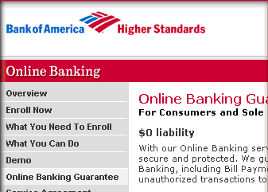
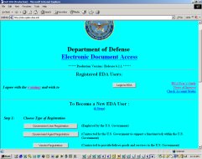
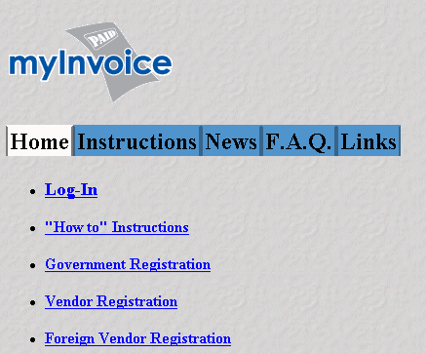

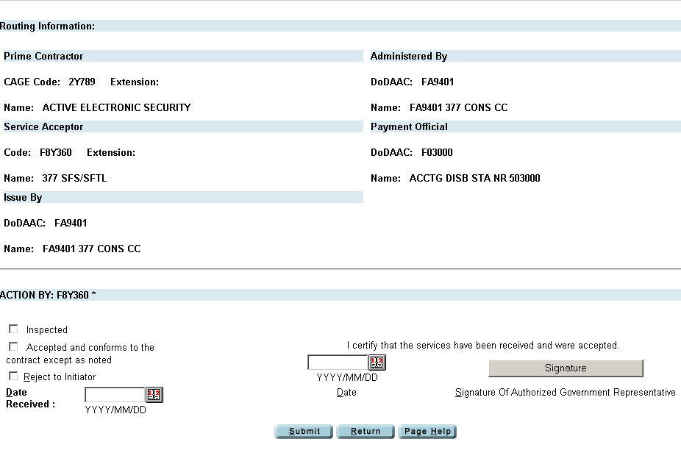
DFAS Electronic Commerce Tools Overview
1
Vendor registers in SAM,
remittance data transmitted to
EC systems / Corporate Electronic Fund Transfer (CEFT)
5
Vendor receives payment via electronic funds transfer (EFT) and uses myInvoice to track their payment and status of invoice
2
Contracts/mods, vouchers are
posted to EDA
Vendor monitors invoice status and views advice of payment (AOP) in myInvoice
4
Vendor enters invoice and
shipment data into WAWF, or transmit
invoices via EDI
3
Government performs acceptance of
goods and services in WAWF transmitted
to entitlement/accounting systems

Slide 10
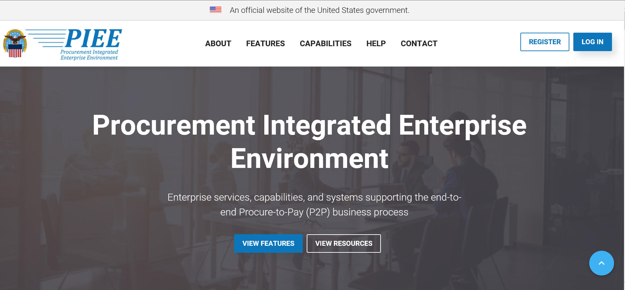
Procurement Integrated Enterprise Environment (PIEE)

Slide 11
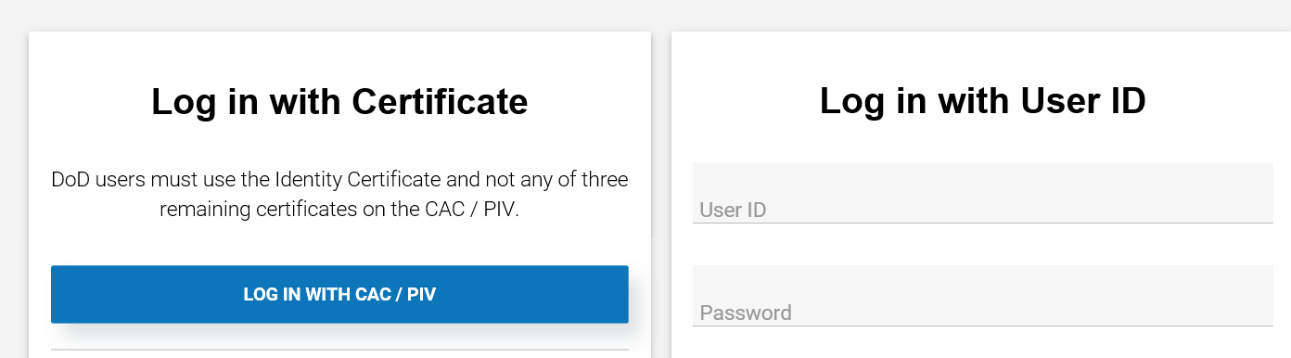
PIEE/WAWF Log In
PIEE delivers access to a number of business applications and capabilities that were once managed independently.

Slide 12
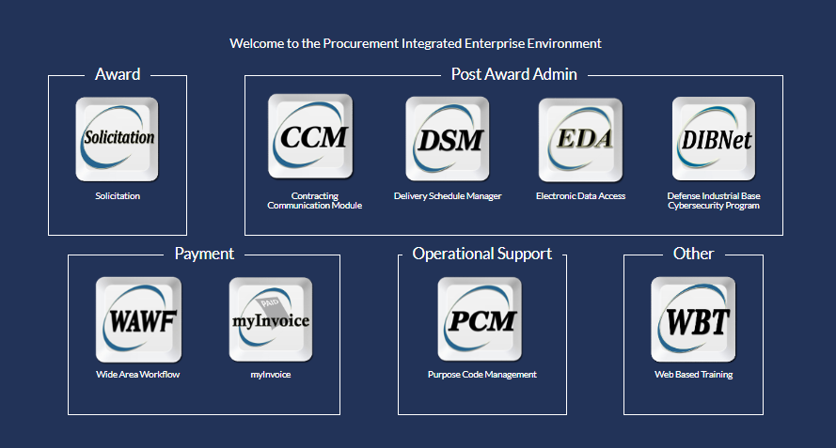
WAWF Module

Slide 13
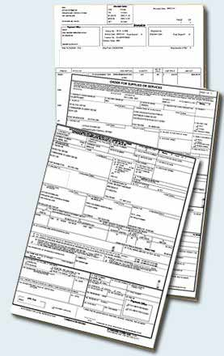
WAWF: Create & Process a Number of Documents
Electronically…
Stand Alone Invoice - FAR 32.905
Fast Pay Invoice - FAR 52.213-1
Invoice 2-IN-1 - FAR 32.905
Construction Payment - FAR 52.232-5; FAR 52.232-10
Commercial Item Financing - FAR 32.202-1(b); FAR 52.232-29 & -30
Performance Based Payment - FAR 32.1003; FAR 52.232-32
Progress Payment - FAR 32.5; FAR 52.232-16
Stand Alone Receiving Report - DFAR Appendix F, DFARS 52.246-7000
Invoice and Receiving Report (Combo) - FAR 32.905; DFAR Appendix F
Reparables Receiving Report
Invoice and Reparables Receiving Report (Combo)
Cost Voucher – FAR 52.216-7, -13, & -14; FAR 52.323-7
Grant and Cooperative Agreement Voucher
Navy Shipbuilding Invoice (Fixed Price) – DoD FMR Vol 10 CH 7 070205-B
Navy Construction / Facilities Management Invoice
Telecom Invoice (Contractual) - FAR 52.232-25; DFARS 252.211
Miscellaneous Payment
Telecom Invoice (Non-Contractual)

Slide 14
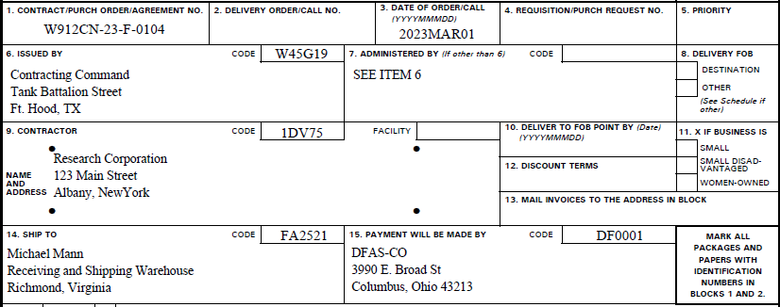
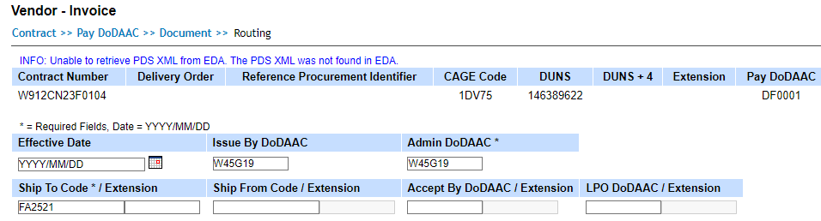
Documents are Routed Through WAWF According to DoD Activity Address Codes (DoDAACs) Entered by Vendor
Contract
WAWF

Slide 15
Entitlement/Accounting Systems used to Process Payments
CAPS-W (Computerized Accounts Payable System-Windows)
  Army, Defense Agencies and United States Marine Corps (USMC)
EBS (Enterprise Business System)
  Defense Logistics Agency (DLA)
IAPS-E (Integrated Accounts Payable System - Electronic)
  Air Force
MOCAS (Mechanization of Contract Administration Services)
  Defense Contract Management Agency (DCMA) and all the Military Services
One Pay
  Navy, Defense Agencies, and USMC
Navy ERP (Enterprise Resource Planning)
  Navy
GFEBS (General Funds Enterprise Business System)
  Army
DEAMS (Defense Enterprise Accounting and Management System)
  US Transportation Command (USTRANSCOM) and Air Force
DAI (Defense Agencies Initiative)
  Defense Agencies and USMC

Slide 16








How Does It Work?
WAWF Receipts & Acceptance Process
WAWF
4 ways to input
1. Web Input
2. SFTP
3. EDI
4. Mobile Device
6.
Bank
1.
WAWF transmits
WAWF transmits payment actions
EDI 810C, 856, & 861
via Global Exchange Services (GEX) to DoD pay systems
payment actions
via DEBX to DoD
EFT
Vendor
Creates/submits invoice and/or receiving report.
pay systems.
DoD Pay Systems
DFAS entitlement system processes payments that match on invoice, receiving report, and contract. Authorizes transfer of funds via EFT to Vendor’s bank.
2.
5.
4.
WAWF External Interfaces
SAM
CEFT
Defense Automatic Addressing System (DAASC)
EDA
Government Inspector
Receives email notification of awaiting actions. Accepts or rejects using WAWF.
3.
DFAS Payment Office
Receives email notification of awaiting actions. Researches any suspended transactions or rejects document to the initiator.
Government Acceptor
Receives email notification of awaiting actions. Accepts or rejects using WAWF.
Local Processing Office
Receives email notification of awaiting actions. Accepts or rejects using WAWF.

Slide 17




Combo Invoice/Receiving Report Workflow
Vendor
Inspector
Acceptor
LPO
Local
Processing
Official
(Optional)
Pay Office
(Optional)
Invoice
Invoice
RR
RR
RR
RR
Invoice and Receiving Report move as 2 Separate Documents

Slide 18



Invoice 2-in-1 Workflow
Inspector
(Optional)
Acceptor
LPO
Local
Processing
Official
(Optional)
Contractor
Pay Office
Invoice/
RR
Invoice/
RR
Invoice/
RR
Invoice/
RR
Invoice and Receiving Report move as One Document

Slide 19
WAWF Status
WAWF Status | Location / Comments
Accepted | Certifier's folder (if in the workflow) or in the Pay Office
Approved | Certifier's folder (if in the workflow) or in the Pay Office
Certified | Pay Office
Correction Required | Inspector makes Receiving Report available for correction
Hold | On Hold within a government user's folder
In Process | Was Reviewed by a Reviewer Approver's folder
WAWF Status | Location / Comments
Inspected | For Source/Source workflow - was forwarded to Pay Office unless an LPO is in the workflow For Source/ Destination or Destination/ Destination - was forwarded to the Acceptor For Cost Voucher – document was provisionally accepted by the DCAA Auditor and has been forwarded to the Pay Office unless an LPO is in the workflow
Navy - In Process | Extracts sent to the Navy Logistics systems. This follows normal document workflow

Slide 20
WAWF Status (Continued 2 of 3)
WAWF Status | Location / Comments
Paid | Status is an active link to the Historical Payment Information. Clicking on this status displays the information relevant to the actual payment, i.e., Disbursing Station Symbol Number, Voucher Number, and Amount of Payment
Pre-Certified | Local Processing Office
Pre-Inspected | For NAVCON Invoice - available in the Inspector's Inspection folder
WAWF Status | Location / Comments
Recall Available | Pay Official made a document available for recall by the previous workflow user
Rejected | Sent back to the Initiator by the Government
Resubmitted | Corrected by the Initiator and resubmitted for action (only seen following a rejection by the Government)

Slide 21
WAWF Status (Continued 3 of 3)
WAWF Status | Location / Comments
Reviewed | Reviewed by a Pay Clerk Remains in Pay Office awaiting Processing
Submitted | Created by Vendor and is awaiting initial government action RR which was created by the government and is awaiting initial government action
Suspended | Pay Office Did not successfully interface into entitlement system
WAWF Status | Location / Comments
Void | An Invoice may only be voided after an LPO or Payment Official has rejected it
Processed | Acknowledgement from entitlement system that transaction successfully interfaced Extracted from WAWF for entitlement systems w/out acknowledgement functionality
Extracted | Transaction extracted from WAWF, awaiting electronic response from entitlement system

Slide 22
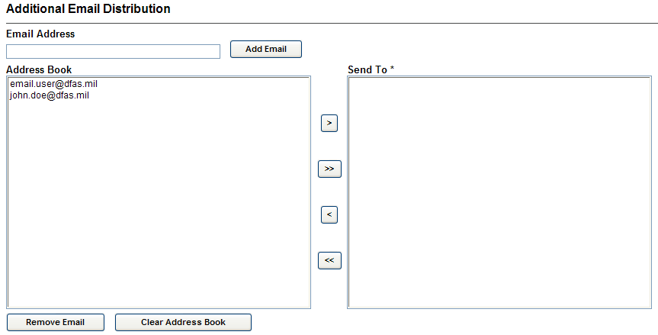
WAWF Can Send Multiple Email Notifications
WAWF uses a unique e-mail for notifying the various users within the workflow of actions to be taken and document status
Users have ability to send notifications to additional e-mail addresses following an action
E-mail addresses are saved for future use after submitted
These system generated e-mail notifications of actions taken, assists all parties monitoring the process and initiating corrective or follow-up actions

Slide 23
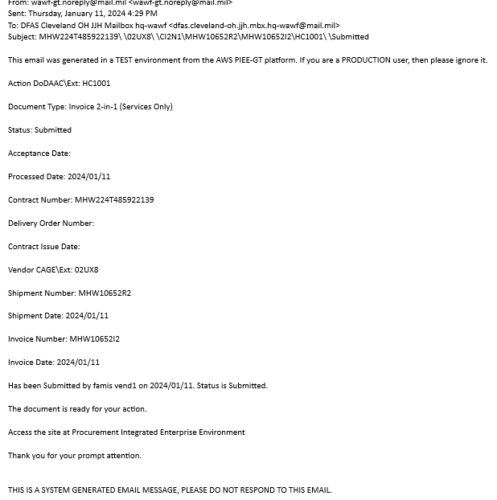
Sample Email Notification

Slide 24
WAWF Government Role Functionality
Online ability to review documents and compare products/services to the contract terms
Ability to electronically reject improper documents for modification
Capability to electronically document inspection and/or acceptance, etc., and digitally sign the information which ensures prompt presentation of the required data to the payment office
Government official can perform many processes in WAWF, depending on their WAWF role, to include:
  Inspect
  Accept
  Reject
  Approve
  Review
  Certify
  Process
  Place documents on hold
  View documents and check document status
  Create Receiving Reports (Only Inspector and Acceptor Roles)
  Correct and resubmit documents he/she has submitted that were rejected
  Void documents he/she has submitted
  Recall documents he/she has submitted or worked, make changes and resubmit the documents
  Make available for Recall documents he/she has worked

Slide 25
PIEE: My Invoice Utilization Advantages
Saves time and limits contacts to customer service for invoice status updates.
Allows review of processed invoices and obtain information associated with the payment.

Slide 26
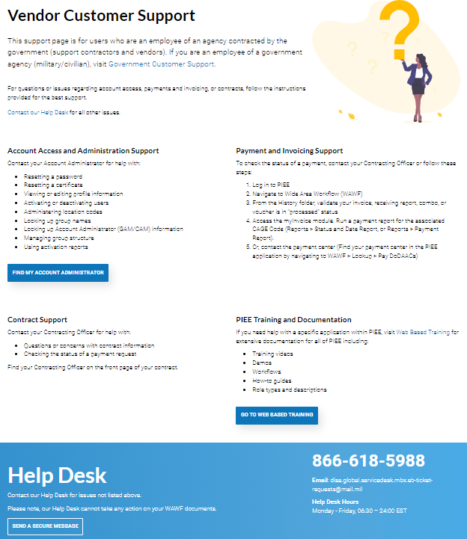
Ogden Help Desk for Vendors
https://cac.piee.eb.mil/xhtml/auth/web/homepage/vendorCustomerSupport.xhtml

Slide 27
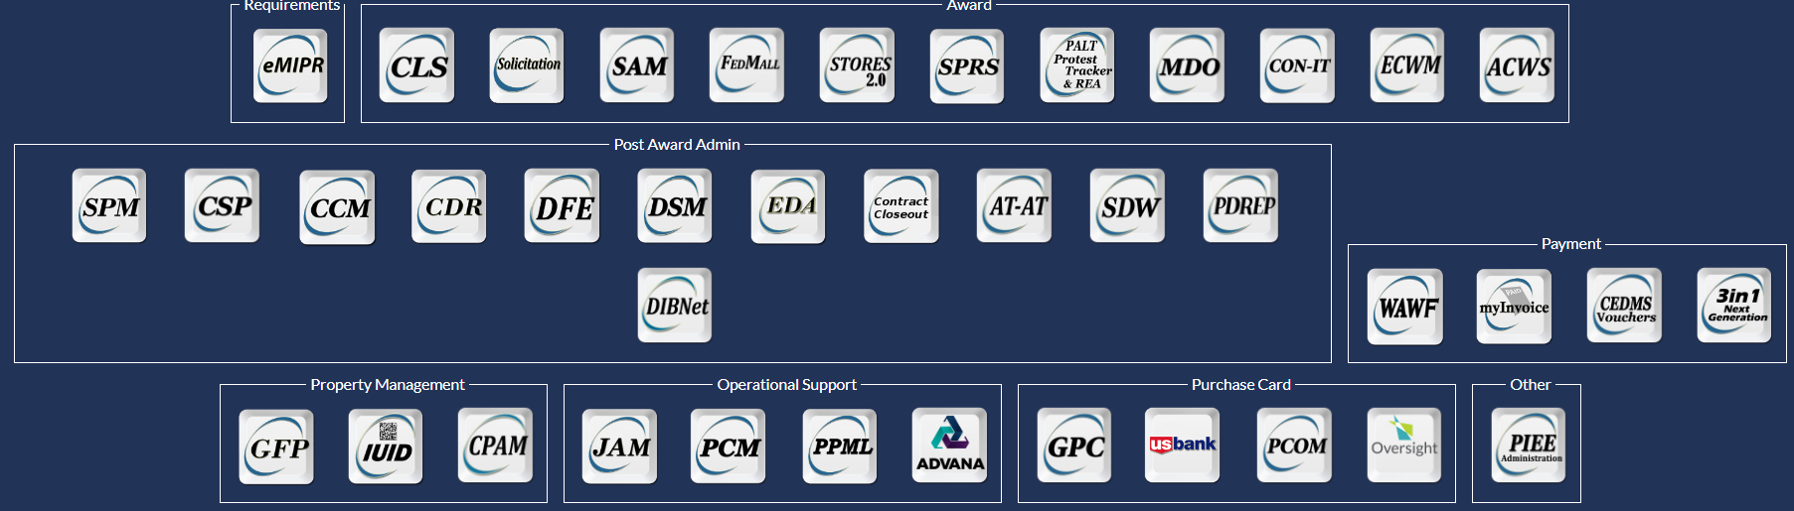

PIEE: Web Based Training
You can select any of the below modules to get further information
https://pieetraining.eb.mil/wbt/

Slide 28
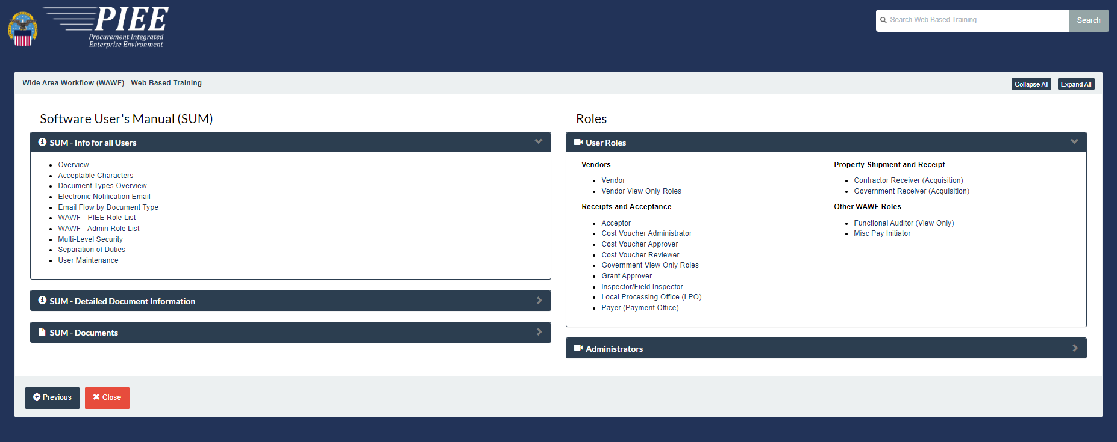
WAWF: Web Based Training

Slide 29
For More Information
WAWF Production Website
  https://piee.eb.mil
DoD Radio Frequency Identification (RFID) Info
  http://www.acq.osd.mil/log/rfid/index.htm
Unique Identification (UID)
  http://www.acq.osd.mil/dpap/pdi/uid/index.html
  (269) 961-4745 Help Desk
  8am - 4:30pm (Eastern Time)
Federal Acquisition Regulation Web Site
  https://www.acquisition.gov/browse/index/far
DFAS Customer Service: 1-800-756-4571

